Slide 1
Driving Distances: Do I drive more than the average American?
Diane Blake
Metro State
DATA 211

Slide 2
Question to explore: Do I drive more than the average American?
Does it matter what day of the week it is?

Slide 3
Data Collected over 2 week period
14 observations
Variables: Distance traveled, day of the week

Slide 4
Hypothesis Testing
I drive more than the average American each day.
Variables:
Dependent: miles driven
Independent: day of the week

Slide 5
According to the Department of Transportation, the average American drives 37 miles/day.

Slide 6
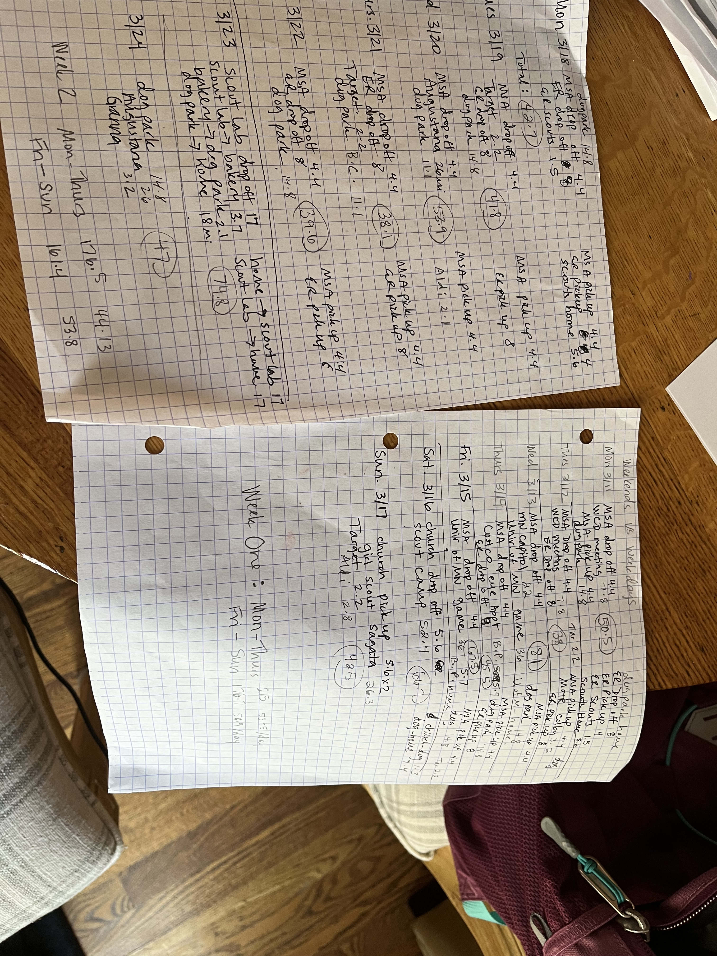
Data Collected: my mileage for 14 days

Slide 7
The way to get stared is to quit talking and begin doing.
H0: My mileage=average American mileage of 37 miles/day
H1: My mileage>average American mileage of 37 miles/day
Walt Disney

Slide 8
T-test in R
P value is .0008891 which is lower than .05 which means we reject the null hypothesis. We can assume with 95% confidence I drive significantly more each week than the average American.
One Sample t-test data: miles_driven$Mileage t = 3.9141, df = 13, p-value = 0.0008891
alternative hypothesis: true mean is greater than 37 95 percent confidence interval: 45.2758
Inf sample estimates: mean of x 52.11429

Slide 9
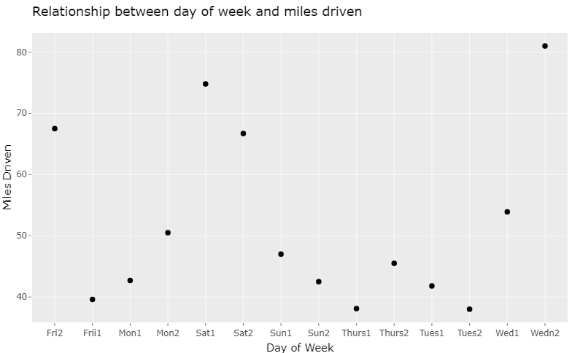
Scatter plot Graph
them to you right there.

Slide 10
Weekend Driving
T-Test just for Friday-Sunday driving
Weekend P-value
The weekend driving P-value is 0.01268 which is also less than .05. Again, we can assume with 95% confidence that I drive more than the average American. But there were only 6 data points analyzed.
One Sample t-test
data: wknd$Mileage
t = 3.1505, df = 5, p-value = 0.01268
alternative hypothesis: true mean is
greater than 37
95 percent confidence interval: 43.97396
Infsample estimates:mean of x 56.35

Slide 11
Thank you
Diane Blake

